Slide 1
Software Design and Architecture
Dr. John Businge
John.businge@unlv.edu

Slide 2
Anouncements
Next Thursday, Feb 9
Recruiters from Hill Air Force
Kane Toomer (Talk about campus resources, important dates, and the advanced standing process)

Slide 3
Learning objectives
Apply the Class Responsibility Collaborator (CRC) technique to analyze and design the object-oriented model for a problem.
Explain and apply object-oriented modeling principles and their purpose (e.g., abstraction, encapsulation, decomposition, generalization).
Explain and apply object-oriented modeling principles and their purpose (e.g., abstraction, encapsulation, decomposition, generalization).
Express object-oriented models as Unified Modeling Language (UML) class diagrams.
Translate between UML class diagrams and equivalent Java code.
Apply design guidelines for modularity, separation of concerns, information hiding, and conceptual integrity to create a flexible, reusable, maintainable design.
Explain the tradeoff between cohesion and coupling.

Slide 4
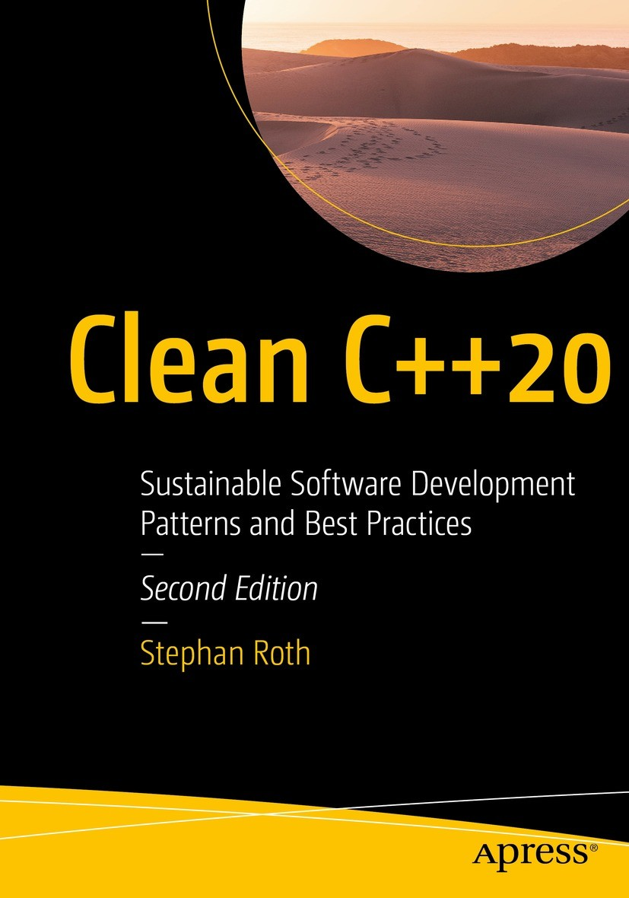
Free PDF version on Springer
Notes:
This a good read. While the code are written in C++, the concepts are general to any programming language.
All the code snippets I use in these slides are in Java

Slide 5
Software design questions
Did they have a good design?
Could the design be done better?
Was there even a design at all?
How do you know if the software was well-designed?
Think of how easy it was to make changes to your code.
Did a small code change produce a ripple-effect for changes elsewhere in the code?
Was your code hard to reuse?
Was the software difficult to maintain after a release?
Notes:
You may have worked on small programs, so you may worked on a larger-scale system.
Take a minute and think of the projects that you worked on.
If you answered yes to any of these questions, chances are you could benefit from a better design. Good design isn't just about code

Slide 6
What is Software Design and Architecture? How does it improve your software products?
Notes:
We will find out shortly

Slide 7
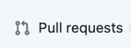
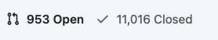
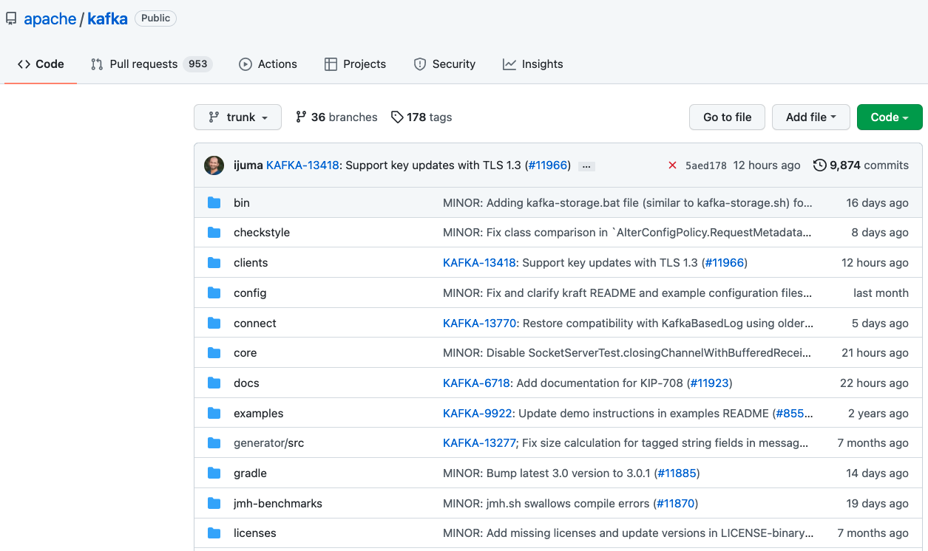
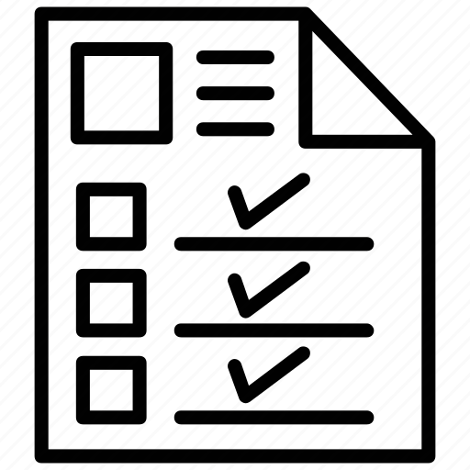

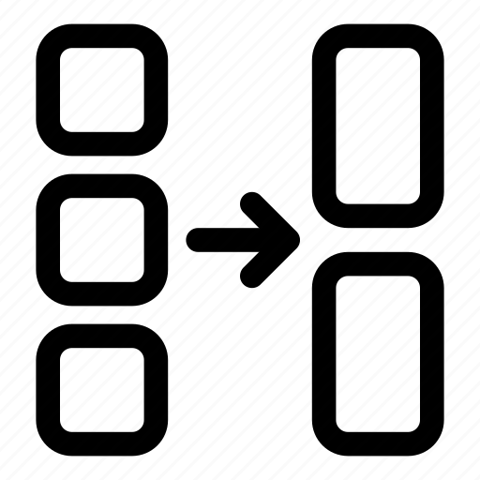



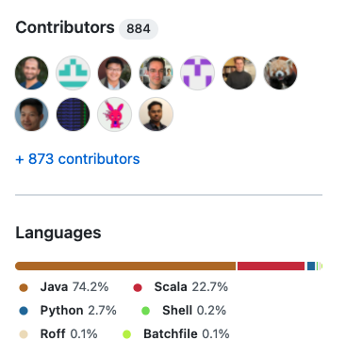
1.7k
Apache Kafka is a distributed event store and stream-processing platform
7
Notes:
Consider this scenario.
You join a project that's been in development for a while.
You look at the code and become instantly overwhelmed.
If there is no high level design of the code, your life would be a living hell for you to do anything on this project
This picture is an example of a repository and I'' explain what social coding i
This picture pretty much sums up most of the elements of my talk
- >9K Revisions (commits),
- 12K pull requests or change requests (new features, bug fixes, refactorings, optimizations, dependency upgrades, and test cases)
- There are over 1.7k contributors responsible for the PRs
- some of the 11K forks are responsible for these PRs
- The repository is written in a range of programming languages

Slide 8


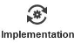

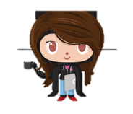

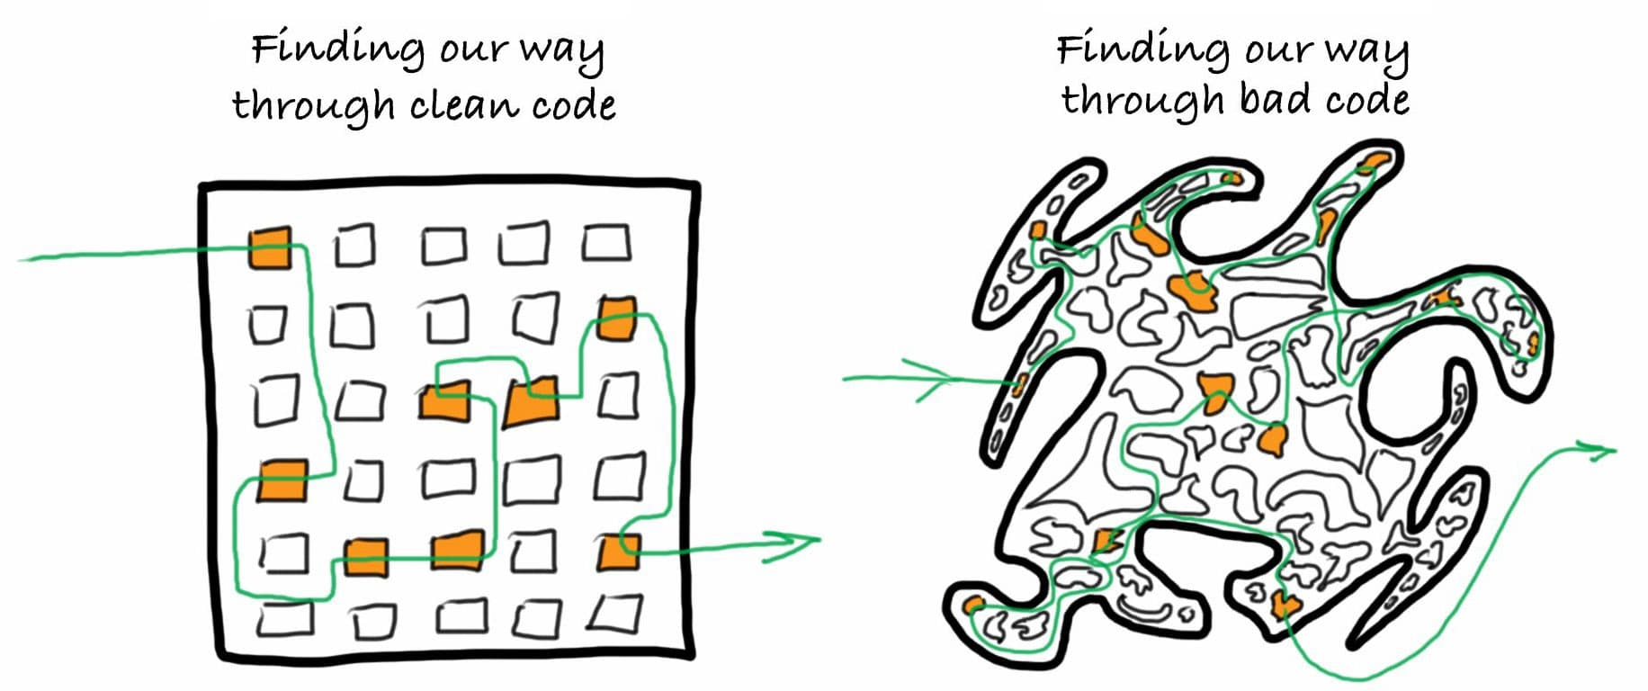
New feature
straight implementation
https://lvivity.com/how-to-write-good-code
Notes:
Or let's say that you are now working on a personal development project. When you began, you weren't quite sure what the functionalities would be, but you just started coding.
It didn't matter that the code was unorganized because you were the only one working on it and you know how it works.
You come up with a great new feature for your product, but in implementing it, you broke the program elsewhere.
You should have designed it right. I'm guessing that you have experienced scenarios like these.

Slide 9
What is Object Oriented Modelling?
Object-Oriented Modelling
When solving a problem, object-oriented modeling involves the practice of representing key concepts through objects in your software. Depending on the problem, many concepts, even instances of people, places, or things, become distinct objects in the software.

Slide 10
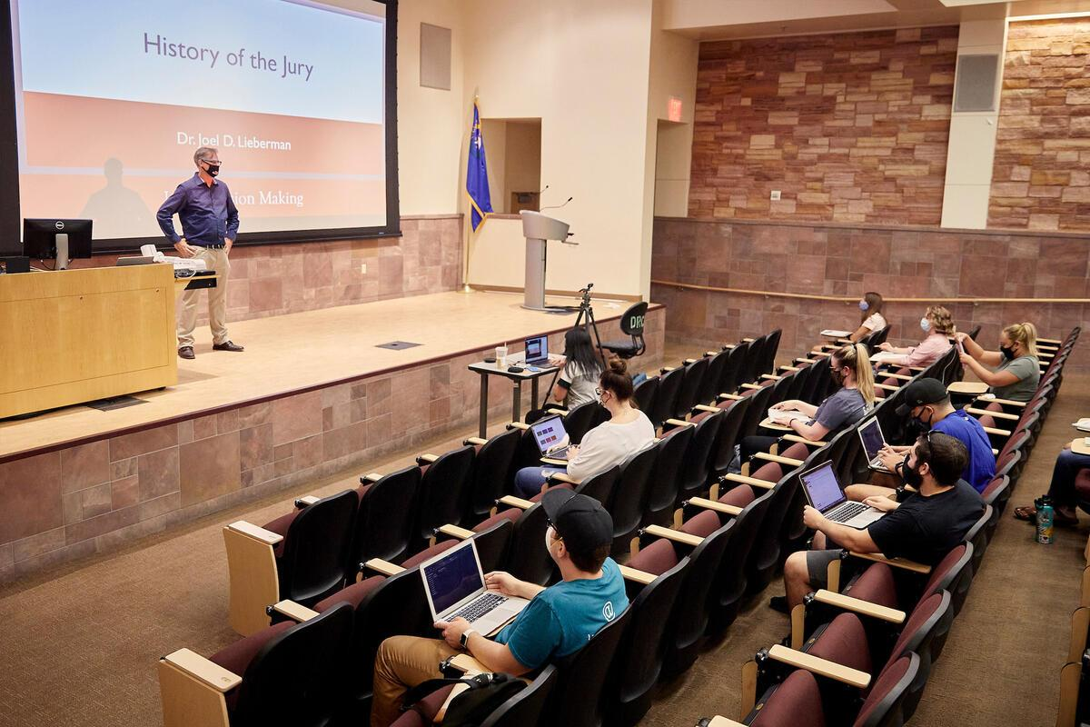
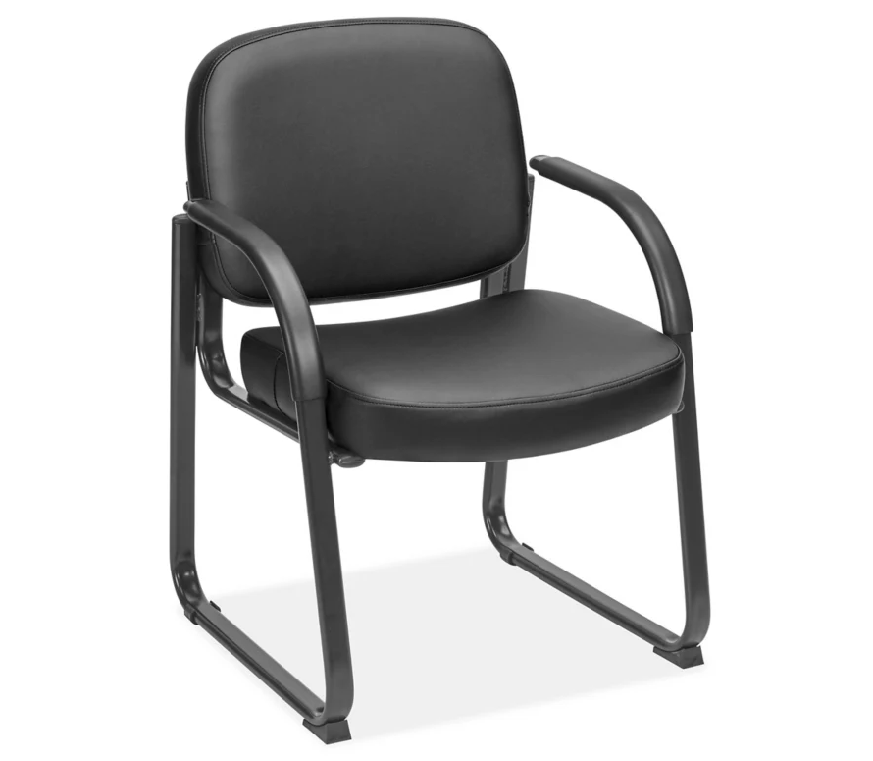
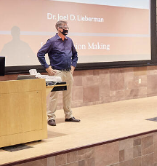
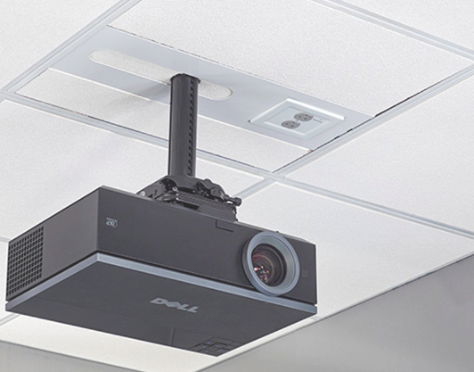
Seat Dimension
age,
gender occupation
Specs
resolution
brightness
Notes:
Think in terms of objects. Objects are all around you. Take a look around; what do you see? We have computers, people, chairs, and many other objects.
Each of these physical objects could be represented by objects in software. There are specific details associated with each object.

Slide 11
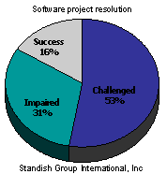
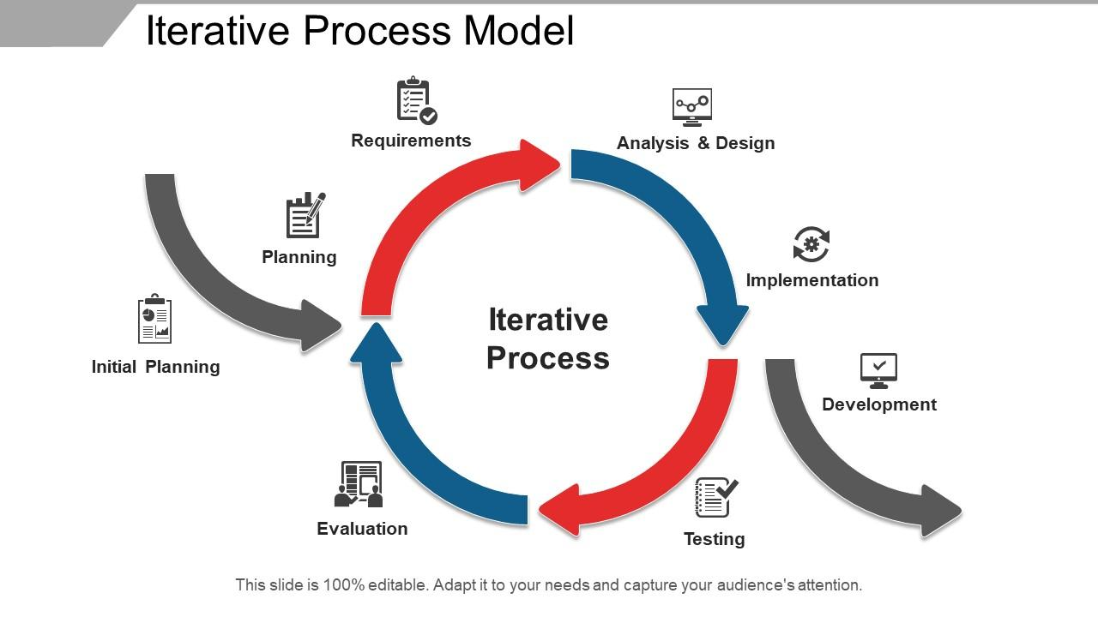
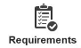
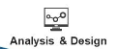
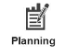
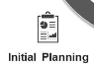

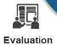
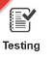
Software Requirements, Conceptual and Technical Designs
Jumping Straight
Iterative Process
Deployment
Notes:
Developing software is an iterative process, with each iteration taking a set of requirements through to a working and tested implementation and eventually building up a complete solution.
Many developers are eager to go straight into coding despite not fully understanding what to program in the first place. Evidence suggest that diving straight into implementation work is a leading cause of project failure. In a survey from The Standish Group, the most common causes of project failures are related to issues in requirements and design.

Slide 12
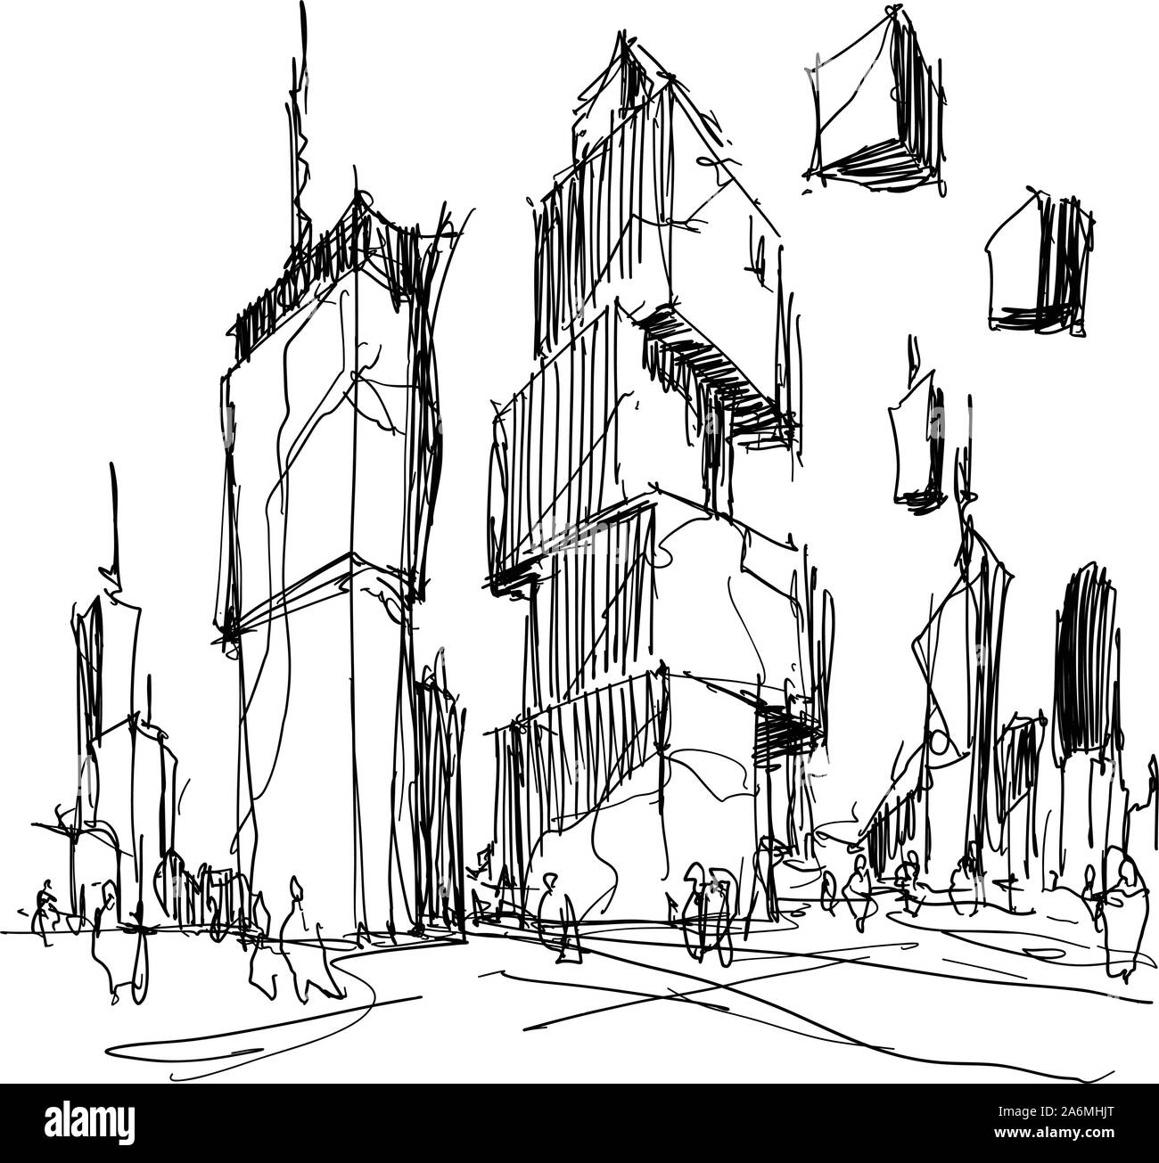
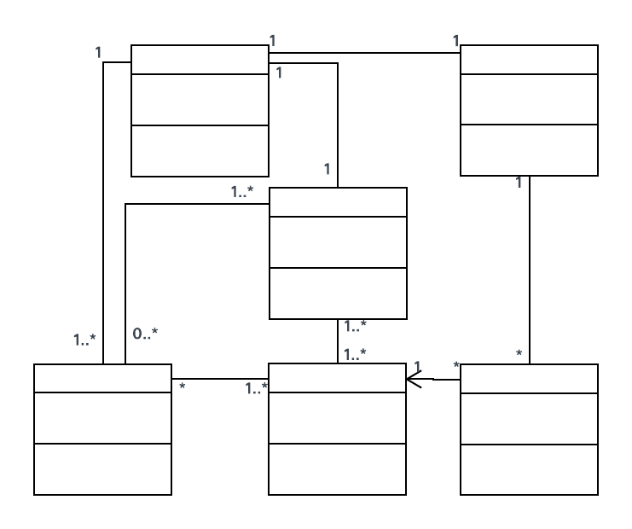
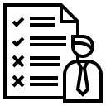
Software Requirements, Conceptual and Technical Designs
Problem Space
Solution Space
Requirements
Conceptual Design
Technical Design
Notes:
The design activity involves taking requirements and outlining a solution. This activity involves producing a conceptual and then a technical design, resulting in two corresponding kinds of artifacts, conceptual mock-ups, and technical diagrams.

Slide 13
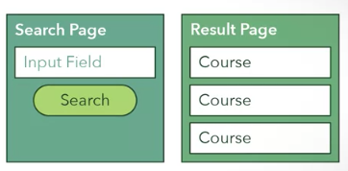
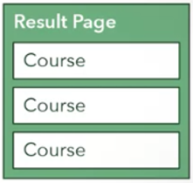

Software Requirements, Conceptual and Technical Designs
University course search website
Design
Goal
Classes
Functions
Components
Components
Conceptual Design
Notes:
This is an example of a conceptual design for a university course search website.
The website has several components that include a Search page, input field, etc

Slide 14
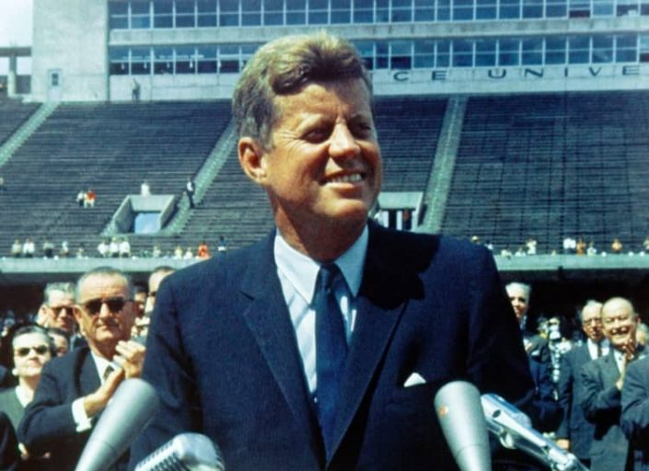
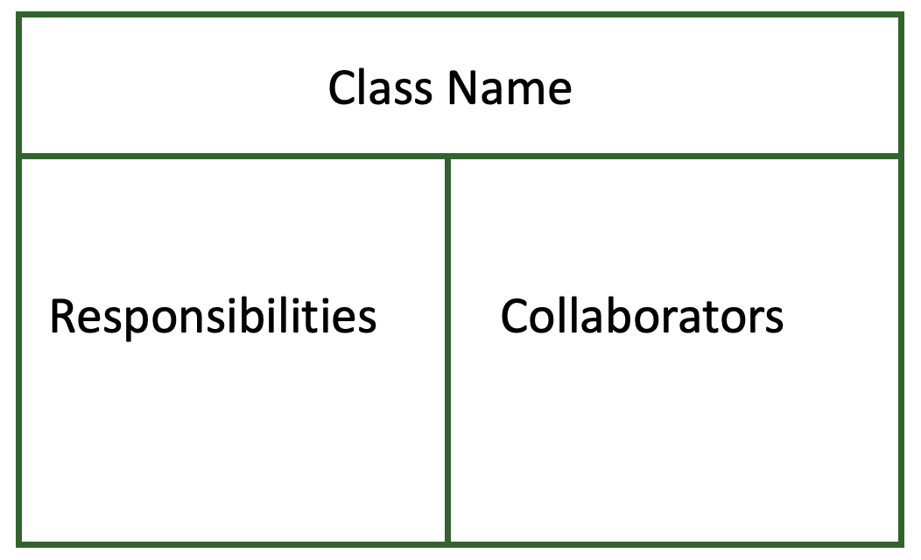

Class Responsibility Collaborator (CRC)
Notes:
Let us discuss the CRC that us supposed to help us design a conceptual design
We can relate the designing software to planning a speech. Great orators usually write note cards are often used when planning a speech.
You can represent each of your talking points on a card.
It would be nice if we had something similar to map out the structure of the software logically when forming its design. The good news is we do.
Similar to how note cards help you organize your talking points. CRC cards help you to organize your components into classes, identify the responsibilities and determine how they will collaborate.

Slide 15

Compoents
Bank Customer
Bank machine
Card Reader
…
Notes:
To illustrate CRC in software design, lets use an example of an ATM machine

Slide 16
Class Responsibility Collaborator (CRC)
CRC Design for Bank Machine System
Bank Customer
Bank Machine
Responsibilities
Insert bank card
Choose operation
Collaborators
Bank Machine
Responsibilities
Authenticate bank customer
Display task options
Deposit and withdraw
Check balances
Collaborators
Bank Customer
Notes:
Since the bank machine is required for our bank customer component to fulfill its task, we placed bank machine under the collaborators section of the bank customer card. Next, let's do the other component, the bank machine on another CRC card. We write bank machine in the class name section. The machine's responsibilities include authenticate bank customer, display task options, deposit, withdraw and check balances.

Slide 17
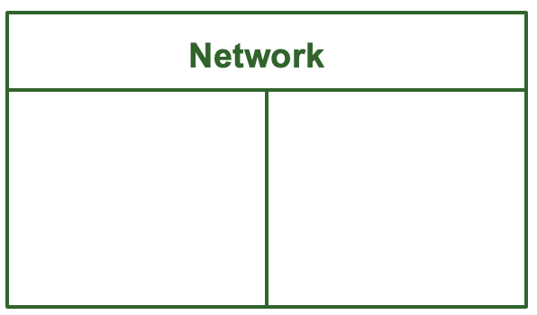
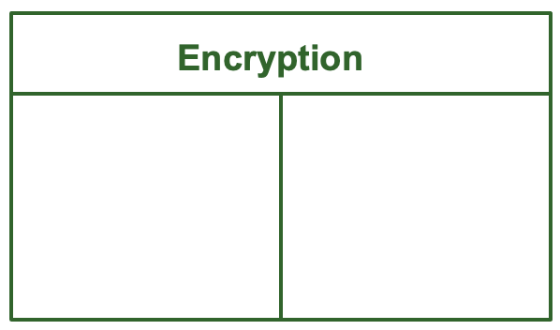
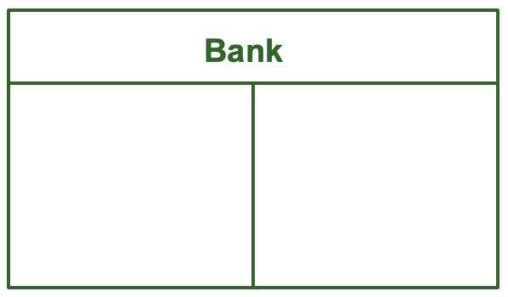
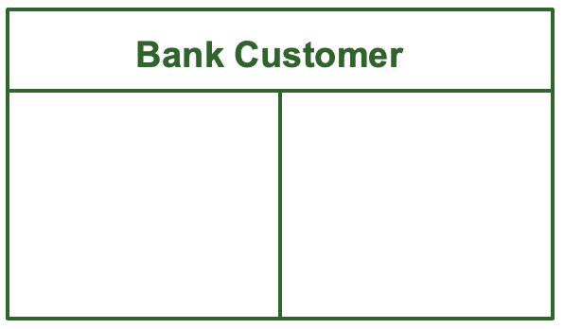
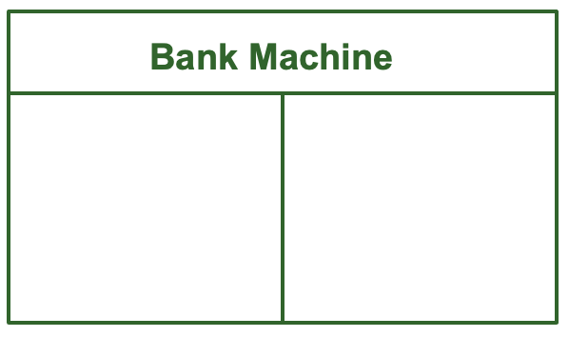
Card Reader
Keypad
Display
Cheque Slot
Cash Dispenser
Notes:
You can find more candidate components by using CRC cards to prototype and simulate various scenarios. For instance, since the bank machine will talk over a network to the bank, you can add a network CRC card between them. You want the network communication to be secure, so you make the network collaborate with a new component called encryption. This component supports secure communication with the bank.

Slide 18
Object-Oriented Modelling
Major Design Principles
Abstraction
Encapsulation
Decomposition
Generalization
High Quality Software
Flexible
Reusable
Maintainable
Notes:
In the conceptual design we were understanding the problem space. Now let us dive deeper into Object-Oriented Modelling which is a step closer to the solution space.
We are going to explore four major design principles used in Object-Oriented Modelling. These principles help in problem-solving and lead to software that is flexible, reusable, and maintainable.

Slide 19
UML Class Diagram
In software, developers use technical diagrams called UML Diagrams to express their designs. A UML Class Diagram, or just Class Diagram for short, allows you to represent your design in more detail than CRC cards can but it's still visual. Class Diagrams are much closer to the implementation and can easily be converted to classes in code.
Notes:
Before diving into the design principles, lets us discuss the tool that we shall use during design.

Slide 20
Abstraction
Abstraction is the idea of simplifying a concept in the problem domain to its essentials within some context. Abstraction allows you to better understand a concept by breaking it down into a simplified description that ignores unimportant details.
Notes:
Abstraction is one of the main ways that humans deal with complexity.
Good abstraction emphasizes the essentials needed for the concept and removes details that are not essential.

Slide 21
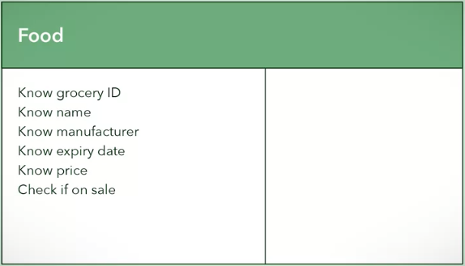
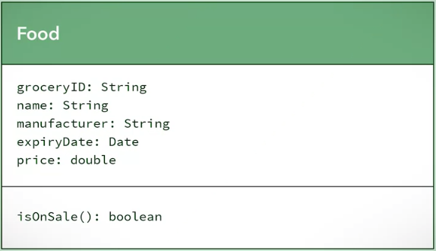
Abstraction in UML and Code
Abstracting a Food component
Class Name
Properties
Operations
Design
Goal
Classes
Functions
Components
Components
Notes:
Let us take an example of abstracting a food component in a supermarket.
A CRC Diagram for a food component would look like this.
CRC cards represent components; if you remember early on, the design goal is for the components to become functions, classes, or collections of other components when they are refined enough.
Since we use OOP in this course, abstraction is formed in a class, we focus on classes.
So how would the food class look in a Class Diagram? This is the Class Diagram representation of the food class.

Slide 22
Abstraction in UML and Code
public class Food{
}
public String groceryID;
public String name;
public String manufacturer;
public Date expiryDate;
public double price;
For now
Class Name
All variables - public
Later
Properties
Variables
Access Modifiers
public boolean isOnSale( Date date ) {
}
Operations
Methods
Properties: <variable name>:<variable type>
Operations: <name>( <parameter list> ) : <return type>
Notes:
Now that we have a Class Diagram representation, let's finally implement it in Java. Class Diagrams are very close to implementation, making the translation to Java very easy. Class name in Class Diagram turns into a class in Java. Properties in the Class Diagram turn into member variables. And finally, Operations turn into methods. You will probably notice that everything is public. We will assume that for now. Later, we will learn about access modifiers of member variables and methods.
Class name in Class Diagram turns into a class in Java. Properties in the Class Diagram turn into member variables. And finally, Operations turn into methods. You will probably notice that everything is public. We will assume that for now. Later, we will learn about access modifiers of member variables and methods.

Slide 23
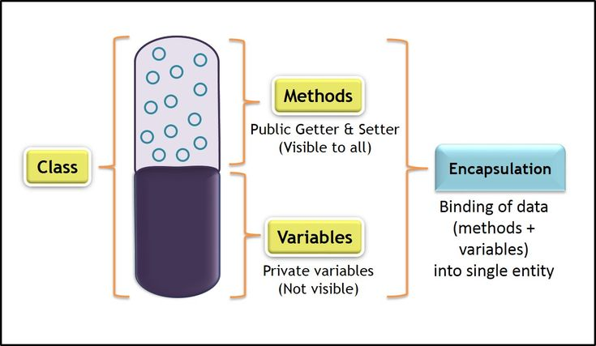
Encapsulation
Notes:
Think of Encapsulation as a capsule
First, you bundle data and functions that manipulate the data into a self-contained object.
Second, you can expose certain data and functions of that object, which can be accessed from other objects.
Third, you can restrict access to certain data and functions only within that object.

Slide 24
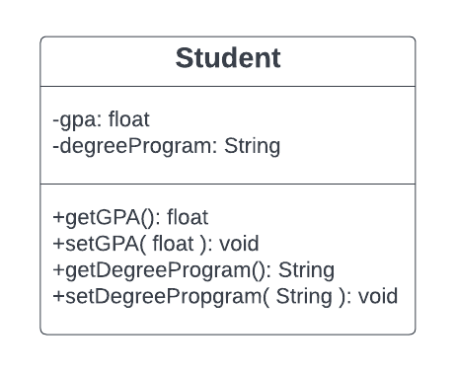
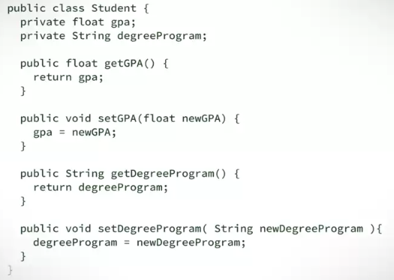
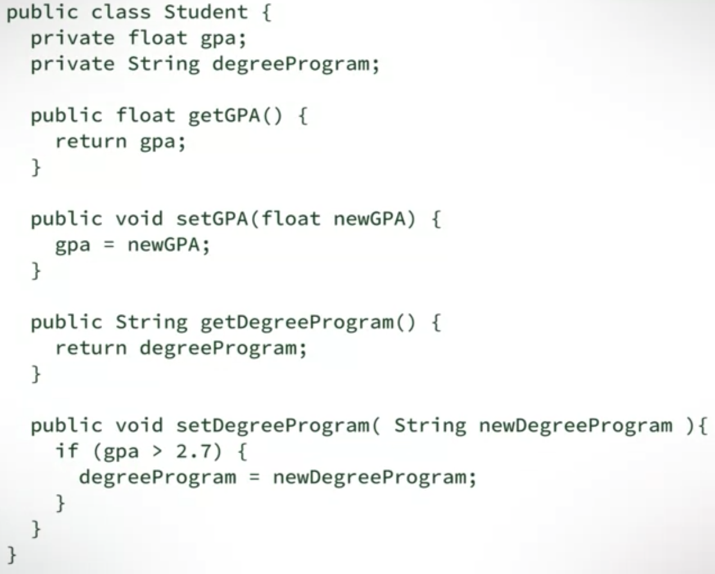
Encapsulation in UML and Code
No manipulation
Class Diagram
Changing data
Restriction on changing data, gpa>2.7
Notes:
Let us use an illustration of a Student Class. Encapsulation helps in providing a protective layer from unapproved manipulation. For example, you do not want your GPA manipulated
Setter Methods change data, and their names typically begin with set and end with the name of the variable you wish to set. Getter Methods are methods that retrieve data, and their names typically begin with get and end with the name of the attribute whose value you will be returning.
Setters are used to set a private attribute in a safe way. Data integrity is why you have Getter and Setter Methods. In order to change a piece of data, you need to go through the correct channels. Data must be accessed in an approved way.
The Getters and Setters do not purely have to return and change private attribute values. They can do more. Let's take a look at our student example. You might have a situation in which there are restrictions on changing the degree program. You can change your code to more accurately display this restriction when it comes to changing the degree program. Let's say that you need a GPA greater than 2.7 in order to be able to change the degree program. this restriction might look like this.

Slide 25
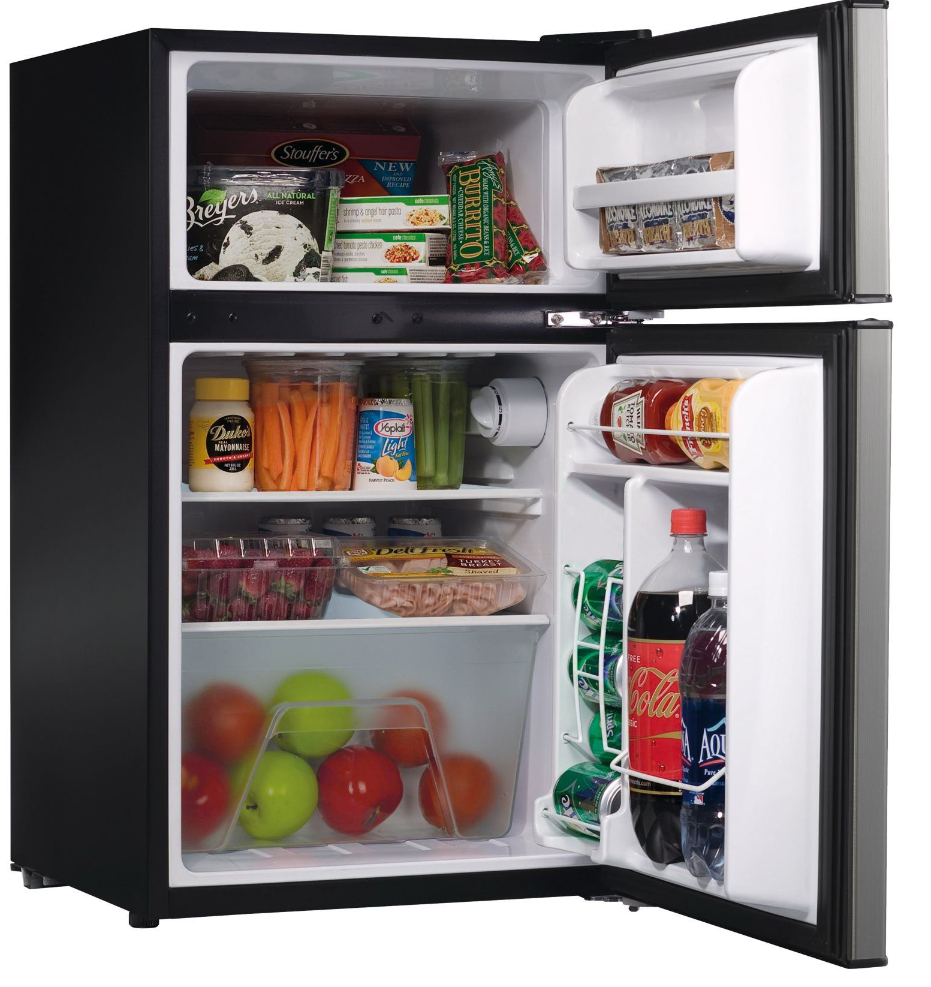
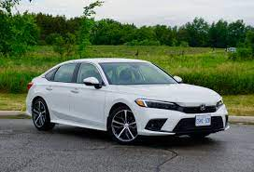
Decomposition
Decomposition is taking a whole thing and dividing it up into different parts. Or, on the flip side, taking a bunch of separate parts with different functionalities and combining them to form a whole.

Slide 26
Decomposition
There are three types of relationships found in decomposition:
Association
Aggregation
Composition
Notes:
A general rule for decomposition is to look at the different responsibilities of some whole thing and evaluate how you can separate them into different parts, each with its specific responsibility. This relates one whole to multiple different parts.

Slide 27
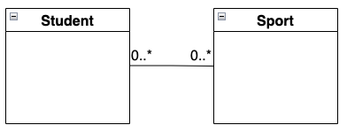
Association
Association is “some” relationship. This means that there is a loose relationship between two objects. These objects may interact with each other for some time.
public class Student{
public void play (Sport sport){
...
}
}
Notes:
Let’s look at an example of Student and Sport
The relationship is between two completely separate objects. A student can play any number of sports. And any number of students can play a sport. Now it’s your turn to develop some code displaying an association.

Slide 28
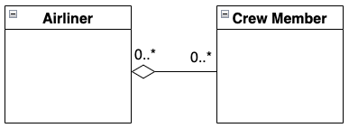
Aggregation
Aggregation is a has-a relationship where a whole has parts that belong to it. The has-a relationship from the whole to the parts is considered weak.
public class Airliner{
private ArrayList<CrewMember> crew;
public Airliner (){
crew = new ArrayList<CrewMember>
}
public void add (CrewMember crewMember)
{ … }
}
Notes:
The next decomposition relationship I will talk about is aggregation.
Do not read this.
Now I will show a code example for aggregation. In the airliner class, there is a list of crew members. The list of crew members is initialized to be empty. And a public method allows new crew members to be added. The airliner has a crew. This means that an airliner can have zero or more crew members.

Slide 29
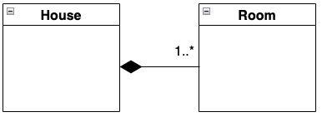
Composition
Composition is an exclusive containment of parts, otherwise known as a strong has-a relationship. What this means is that the whole cannot exist without its parts. If it loses any of its parts, the whole ceases to exist. If the whole is destroyed, then all of its parts are destroyed too.
public class House{
private Room room;
public House (){
room = new Room();
}
}
Notes:
One of the major decomposition relationships is composition.
Compare this to the relationship between a house and a room. A house is made up of multiple rooms. However, if you were to remove the house, its rooms would cease to exist. You cannot have a room without its house.

Slide 30
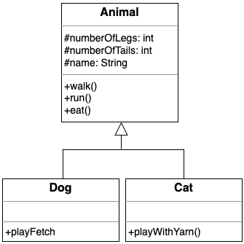
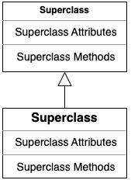
Generalization and Inheritance
public abstract class Animal { protected int numberOfLegs; protected int numberOfTails; protected String name; public Animal(String pateName, int legs, int tails) { this.name = pateName; this.numberOfLegs = legs; this.numberOfTails = tails; } public void walk() { } public void run() { } public void eat() { } }
public class Dog extends Animal{ public Dog(String name, int legs, int tails) { super(name, legs, tails); } public void playFetch() { } }
public class Cat extends Animal{ public Cat(String name, int legs, int tails) { super(name, legs, tails); } public void playWithYarn() { } }
Notes:
Generalization and inheritance help us reduce redundancy.
This is how a superclass and a subclass would look in UML.
As an example, The UML of a Superclass: Animal and the subclasses: Dog and Cat would look like this.
And this is what the code in Java would look like.

Slide 31
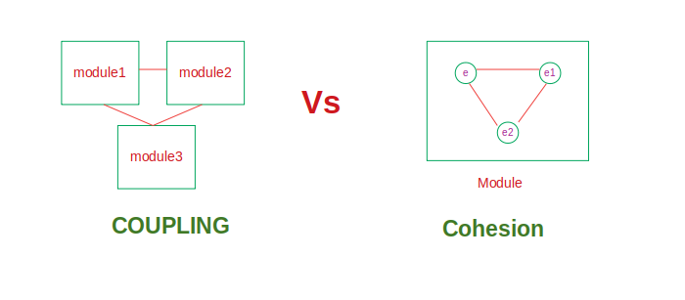
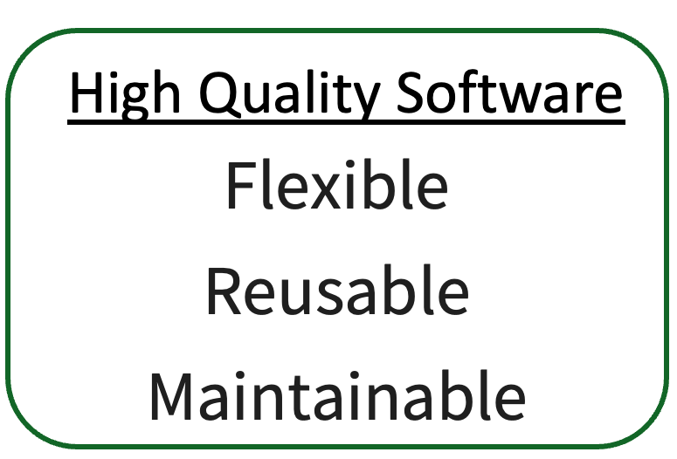

Evaluating Design Complexity
Complexity Between
Complexity Within
Module
Methods
Classes
Coupling
Cohesion
Evaluate
Notes:
In the previous slides we have discussed the principles of OOD
But how do you tell that your software solution is flexible, reusable, and maintainable?
We do that by evaluating design complexity using the metrics: Coupling and Cohesion
When you are programming, keeping modules simple is critical.
Once you design complexity exceeds what developers can mentally handle, bugs will occur more often.
So you must have a way of evaluating your design complexity.
Coupling focuses on complexity between a module and other modules.
Cohesion focuses on complexity within a module.
Module applies to both classes and methods
The metrics you will use to evaluate design complexity are coupling and cohesion.
Cohesion is a measure of the degree to which the elements of a module are functionally related
Coupling is the measure of the degree of interdependence between modules
These two ideas will help you to better apply object-oriented design principles and achieve a more manageable system.

Slide 32
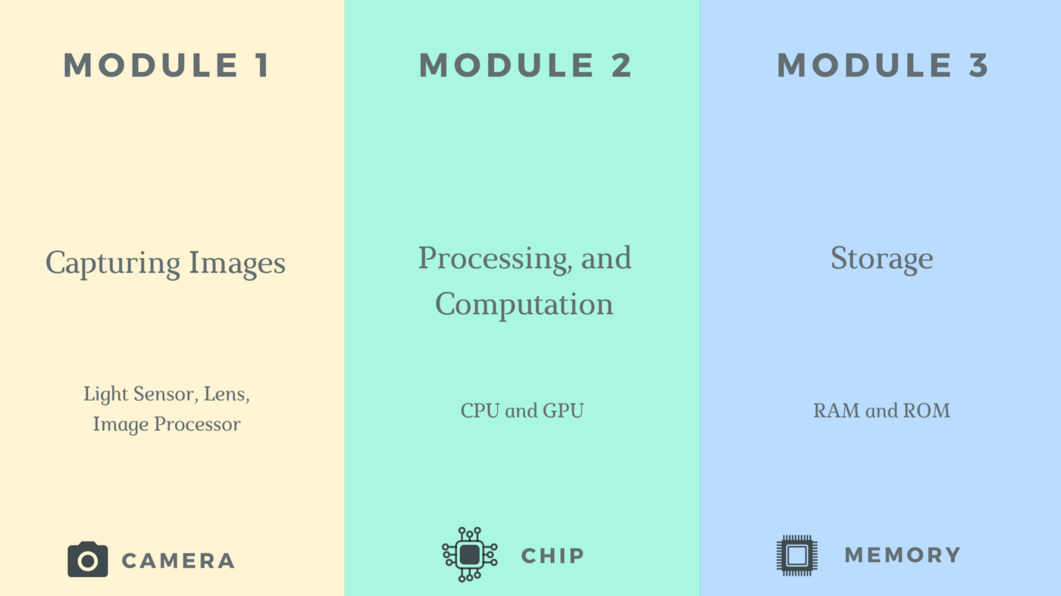





Evaluating Design Complexity
Low cohesion + High coupling
High cohesion + low coupling
High Cohesion - Clear responsibility
Module - single Functionality

Slide 33




Evaluating Design Complexity
Which class has low cohesion and why?
A
B
High Cohesion (only staff details)
Very focused
Low Cohesion
Unfocused
Broad functionality
Don’t check/validate emails in Staff class
Break into 4 classes
Single Responsibility Principle
Easier to maintain (and less frequently changed)
Think deeply about the responsibility

Slide 34


Which of the following is true about Sensor class and its cohesion?
Sensor class has high cohesion, since its purpose is clear.
Sensor class has low cohesion, since its get method is not straightforward.
Sensor class has low cohesion, since it has two purposes and therefore unclear.
Which of the following is true about coupling to the Sensor class?
Sensor class has low coupling, since its purpose is clear.
Sensor class has tight coupling, since it has two purposes and therefore unclear.
Sensor class has tight coupling, since its get method is not straightforward.
Notes:
Question: Given the following class diagram and code, answer the following questions
Cohesion: One purpose is enough for one class. Any more than that takes away from cohesion.
Coupling: A user of the get method will have to open up Sensor to see how it works. That's not loose coupling!
Look at the get method is? Is it clear

Slide 35


Replaced
Tightly Coupled – No clear purpose
Loosely Coupled – Clear purposes
Notes:
Let's look at a new design of the same system.
The sensor class is now replaced with a humidity sensor class and the temperature sensor class.
Each of these classes has one clearly defined purpose. Since each has a clear purpose, you can say that these classes are highly cohesive.
The get method is now not hiding any information like before. We don't have to break encapsulation to look inside the method.
You could reasonably assume that humidity sensors get method returns humidity and temperature sensors get method returns temperature.

Slide 36


Separation of Concerns
So, what is a concern? A concern is a very general notion, basically it is anything that matters in providing a solution to a problem.
Notes:
Once gain, the goal of using software design principles is to help us create a system that is flexible, reusable and maintainable.
One of these principles is called separation of concerns.

Slide 37







Separation of Concerns
Feeds it self?
Separation of Concerns
No separation of Concerns
Dog Behaviors
Notes:
Lets look at the behavior of a dog: A dog can run walk eat.
In reality, a dog would need an owner to feed it. The dog knows how to eat food, but it doesn't know anything about the foods it's eating until its owner feeds it.
We need to separate two concerns,
the action of eating and
the action of providing food.
This can be done by introducing a dog owner class.

Slide 38




Separation of Concerns
Low cohesion
Concern 1
Concern 2
Notes:
Let's illustrate another operation of concerns with the example smartphone.
Two of the responsibilities of a smartphone are to take pictures and make phone calls
However, this snippet of code, implements two of the concerns of the smartphone.
The code does not separate the concerns and there high cohesion and no modularity.

Slide 39



Notes:
First, we will extract the attributes and behaviors of both the camera and
TraditionalPhone into two separate interfaces.
Then, we can implement these interfaces correspondingly with the FirstGenCamera
class and the TraditionalPhone class.
Here is what the code looks like.

Slide 40
Information Hiding
Information hiding allows models of our system to give others the minimum amount of information needed to use them correctly and hide everything else.
Access Modifiers
There are four levels of access in Java:
public,
protected,
default, and
private.
Notes:
Another important design technique is Information hiding.
The module should only have access to the information that it needs to do its job. So how do we limit the information our various modules of our system can have
access to? We do this by applying information hiding.
Information hiding is often associated with encapsulation.
We use encapsulation to bundle attributes and behaviors into their appropriate class, and expose an interface to provide access.
Take a look at this example, the string library has a method called concat. But how is it implemented? Are there extra data structures being used? Or other method calls being made that we do not have access to? As a user of the library you are given access to the concat nation functionality through an interface, a particular method signature. But you are not shown how the functionality is implemented.

Slide 41


Inheritance Issues
No specialization at all
Only calls addTopings()
Can be done in Pizza class
Ask yourself, am I using inheritance to simply share attributes or behavior without further adding anything special in my subclasses? If the answer is yes, then you're misusing inheritance. Superclass should already be enough.
Notes:
Generalization and inheritance are some of the more difficult topics to master in object-oriented programming and modeling.
Well inheritance is a powerful design tool that can help you create clean, reusable, and maintainable software systems. Misusing inheritance can lead to poor code. That happens when design principles are used improperly, creating more problems than they are meant to solve. So how do we know if we're abusing inheritance? Well, there are a few points to be aware of when implying inheritance. First, you need to ask yourself, am I using inheritance to simply share attributes or behavior without further adding anything special in my subclasses?
If the answer is yes, then you're misusing inheritance. This is an indication of misuse, because there is no point for the subclasses to exists since the superclass already is enough.
Let's say, you were designing for your favorite pizza restaurant. You need to model all the different varieties of pizza that the restaurant has on the menu. Given the different combination of toppings and names you can have for pizzas, you might be tempted to design a system using inheritance. The pizza class has been generalized to know what toppings it will have, its size, style of crust, and how long it will take to cook. This seems reasonable, but let's look at why this is a misuse of inheritance by examining the code for a subclass of pizza.
Despite the fact that a pepperoni pizza is a more specific kind of pizza, it is not really different from a superclass. You can see that the pepperoni constructor uses the pizza's constructor and adds toppings using the pizza's method. There's no reason to use inheritance in this case, because you can simply use only the pizza class to build the pizza with pepperoni as a topping The second indication of improper use of generalization is, if you break the Liskov Substitution Principle. The principle states that a subclass can replace a superclass, if and only if, the subclass does not change the functionality of the superclass. How would this principle be violated through inheritance? Let's take a look at this example. This is our generalized Animal class, it knows how to eat, walk, and run. Are you able to see how we can introduce a subclass that would break the Liskov Substitution Principle? What if we had this type of animal?

Slide 42


Inheritance Issues
Substitution of inheritance with depomposition

Slide 43
UML Sequence Diagram
A Sequence Diagrams describes how objects in your system interact
to complete a specific task.
Notes:
Now it's time for you to learn about Sequence Diagrams.
UML sequence diagrams are another important technique in software design.
They are a type of UML diagram, commonly used as a planning tool before the development team starts programming. Sequence diagrams are used to show a design team how objects in a program interact with each other to complete tasks.

Slide 44
A Simple Fast Food UML Sequence Diagram
: Cashier
: Chef
Client
Order (burger)
Order (burger)
burger
burger
Notes:
Let's say that a person wants to order a burger at a local fast food restaurant; here is a simple sequence diagram of the scenario. That person will go to a restaurant, talk to the cashier, and order a burger. The cashier will then talk to the chef of the back to tell him my order. The Chef cooks the burger, gives it to the cashier. And the cashier will give it to the person.

Slide 45
UML Sequence Diagram
Object
: Class
: Class
Messages
Notes:
When creating sequence diagrams,
First you use a box to represent role play by an object. The role is typically labeled by the name of the class for the object.
Second, you use vertical dotted lines, known as lifelines, to represent an object as time passes by.
Finally, you use arrows to show messages that are sent from one object to another.

Slide 46
ATM Process
Withdraw
Deposit
Notes:
A sequence diagram can contain other sequence diagrams within it.
For example, if you are creating a sequence diagram for an ATM, there might be a different sequence for Withdrawals and Deposits.
And during a single process someone might want to do both.
In your sequence diagram, you would have one big sequence of activities with two smaller sequences inside them.

Slide 47
Changing the TV Channel
Change TV Channel
: Remote
: Television
TV Viewer
Press numbers (number)
Change channel (number)
Show change of channel
Notes:
Let draw a sequence diagram for a person watching a television.
First, I'm going start by drawing a box, that will surround the entire process.
Moving on, in the top corner I'm going to draw a label with a meaningful title. Remember, your team will be looking at this diagram as a reference for development, so make the titles meaningful. We will name it Change TV Channel. Next, I'm going to draw out the objects that are important in this task.
To keep things clean, you should draw objects from left to right in the sequence that they interact with each other. In this example, the TV viewer starts the entire process. The use of the remote which will then interact with the TV. So when are diagram, I'm going to drive the TV viewer then the remote and then the TV. If there are people in your example, who will be using or interacting with objects, this are typically draw on a stick figures. We call these people actors, in our example, the TV viewer's an actor. So I'm going to draw them is a stick figure, I'm going to the other objects as labeled boxes.
The first message that is sent is from the TV viewer to the remote. That message says that the TV viewer pressed numbers. So I'm going to add this to the diagram with a solid line arrow and label it Press Numbers, number.
The remote then sends a new message to the television to change the channel to number. We denote this on the diagram with another solid line arrow labeled Change channel, number. This also activates the television object, so I will add a small rectangle to the television's lifeline.
You'll notice that since a television wasn't activated at the beginning of the example, we don't want the rectangle on its lifeline to start at the same place as the TV viewer or the remote. I drew it a little bit lower on the lifeline to indicate it was activated later in the process.
that means I'm going to denote this response using a dotted line arrow. I'm going to draw this arrow from the television object to the TV viewer. This action only affects the television and the TV viewer. The remote is not part of this interaction, so we do not extend the box on the remote's lifeline to include this action.

Slide 48
Changing the TV Channel – Alternative provcesses and loops
Change TV Channel
: Remote
: Television
TV Viewer
alt
[ Viewer knows what channel they want]
Press numbers (number)
Change channel (number)
Show change of channel
[ else ]
loop
[ Viewer does not like the channel ]
Press up/down
Change channel up/down
Show change of channel
Notes:
As you design software, your sequence diagrams can get much more complicated. You can also show loops and alternative processes in a sequence diagram. Let's see what these would look like in a sequence diagram. Say the TV viewer is unsure what channel to go to and would like to surf the channels until they find a channel they like. I can wrap the previous sequence I just drew as part of an alternative process. So that it is a sequence of actions that will occur if a condition is true. So I put the sequence in a box and label it alt, for alternative, in the top right corner. Now, I need to specify when this alternative will occur. In this case, the sequence occurs if the TV viewer knew what channel they would like. We will label this alternative TV Viewer knows what channel they want.
If the TV viewer does not know what channel they want, other sequences can occur. One sequence is that the TV viewer will browse to the channels until they find something to watch. This will be denoted by a look
Right under the label, I put a conditional statement for the loop. If that statement is true, it will go through the loop. Loop sequence should continually occur if the TV viewer does not like the channel they are watching, so I will add that condition to this loop box. The TV viewer is going to press the up or down arrow on the remote to browse through the channels. This sends a message to the remote. The remote will then send a message to the TV with this action. Just like in the initial sequence, the TV changes the channel and displays that to the TV viewer. The final sequence diagram looks like this.
Sequence diagrams are a very powerful too you can use to model your software. Sequence diagrams are commonly used as a planning tool before the development team starts programming, or to show
others how a system is designed. And they can help you to determine the functions you will need to right. It might even help you find problems in your system that you didn't see before. Sequence diagram are another technique you now know that will help you to create clean, well-designed programs.

